Slide 1

Enterprise Procurement & Cost Optimization

Slide 2
THE BUSINESS PROBLEM: FLYING BLIND
Corporate purchase records spanned millions in capital, but executive leadership operated under substantial structural constraints:
Financial Opacity No centralized oversight across a multi-million-dollar corporate purchasing budget. Employee off-contract leakage is actively bypassing corporate savings programs and eroding profit margins.
Unquantified Savings Variance Total absence of structured analytical tools to verify if supplier invoicing matches negotiated corporate agreements. Leadership cannot mathematically validate negotiation ROI.
Latent Quality Losses No systematic linkage between downstream material defects and transactional vendor purchase records. Defective parts enter production without clear supplier accountability.
Logistics Pipeline Disconnect Fragmented and missing timestamps at the receiving dock prevent logistics audits on delivery latency. Management cannot reliably track shipment delays or vendor lead times.

Slide 3
RAW TRANSACTIONAL DATA AUDITING
Before modeling calculations, I executed a structural audit across 1,000+ rows of flat CSV data, isolating several critical data anomalies:
Raw Column Field | Detected Type | Inherent Data Deficiency | Analytical Operational Risk
Order_Date / Delivery_Date | String / Mixed Text | Dates stored under inconsistent syntax formats. | Broke temporal calculations and timeline tracking.
Unit_Price / Negotiated_Price | General / Blank Space | Missing monetary definitions and blank records. | Caused mathematical null errors in sum averages.
Supplier_Name | Unsanitized Text | Rogue trailing/leading whitespaces. | Fragmented pivot metrics into duplicate suppliers.
Compliance | Text ("Yes" / "No") | Strict binary represented as descriptive strings. | Blocked direct mathematical weighting of risk scores.

Slide 4




THE POWER QUERY INGESTION PIPELINE
I architected an automated 4-tier ETL pipeline. By targeting file directory paths directly, any subsequent monthly CSV file additions will transform and self-load automatically:
1. Ingest
2. Cleanse
3. Model
4. Render
Established a live folder query link pointing directly to transactional archives, bypassing manual flat-file copy-pasting.
Executed global string sanitization via Power Query M-code to trim whitespaces and enforce strict data typing.
Constructed backend calculated columns and custom logic rules, bypassing volatile manual sheets entirely.
Saved the pipeline output directly to the workbook **Excel Data Model**, significantly reducing file size and computational lag.

Slide 5



CALCULATED FORMULA & METRIC ENGINEERING
Rather than utilizing flat dimensions, I calculated the strategic business value layers explicitly using custom modeling formulas:
Contract Savings calculation: Determines the exact monetary delta achieved by negotiation teams compared to baseline market pricing.
// 1. Total Negotiated Savings Metric
Compliance Digitization: Converted text-based strings ("Yes"/"No") into strict mathematical binary integers to enable weighted risk-scoring averages.
// 2. Numerical Compliance Conversion
// 3. Error-Handled Defect Metric
Quality Fail Isolation: Formulated error-handled defect percentages per delivery volume.

Slide 6
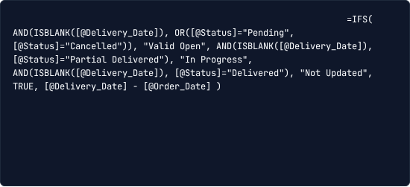
HANDLING TIMELINE EXCEPTIONS
Evaluating lead times dynamically represents a real-world supply chain hurdle. Pending or cancelled shipments have empty delivery fields, causing errors in date subtraction:
Targeted Imputation Gates: Engineered logical layers to inspect shipment status flags before executing date calculations.
// Standardizing dates and handling missing delivery timestamps
In-Transit Separation: Orders on route are flagged safely as "In Progress" without breaking global average timelines.
Dock Failure Isolation: Identified a structural failure where items were checked "Delivered" but lacked scan stamps, isolating them as "Not Updated" for audit reviews.

Slide 7



ISOLATING COST VIA THE 80/20 STRATEGY
To identify where the Chief Procurement Officer should target contract renegotiations, I modeled the Pareto Principle directly within the Pivot engine:
The Spend Core: Plotted cumulative spending totals to verify if 80% of corporate cash is controlled by just 20% of vendors.
Cumulative Percent Formula
Multi-Field Pivot Logic: Duplicated the total spend metric inside the value structure, changing the second array to "% Running Total In" sorted by supplier descending.
Allows the CPO to immediately isolate the precise handful of suppliers requiring priority contract focus.
Visual Integration: Rendered a dynamic dual-axis Combo chart mapping static spend blocks alongside a running cumulative percentage curve.

Slide 8




THE "INVISIBLE BRIDGE" UI ARCHITECTURE
I structured a clean UI that mimics native web applications, bypassing slow Excel default slicer actions through a decoupling technique:
1. Custom Slicers
2. Secret Pivot Bridge
3. Dynamic Lookup
Constructed native dashboard slicer fields, completely customized to operate as slick, website-like selection buttons.
Selection triggers secretly update a hidden 1-cell Pivot sheet (`Bridge_Sheet!$P$2`) holding target records.
Direct KPI UI blocks read the bridge coordinate via index functions, updating statistics instantly without screen flashing.
// UI calculation parsing user interactive clicks

Slide 9
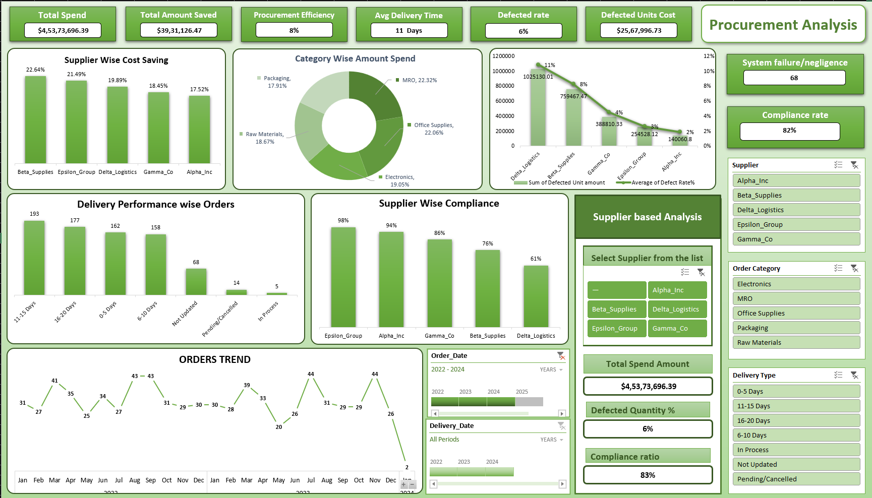
INTERACTIVE EXECUTIVE CONTROL CENTER
Dashboard Design Protocol
The finished production dashboard features a highly professional, polished **Sourcing-Green palette**, systematically clean charts, and rapid slicer responsiveness.
Real-Time Audits: C-Suite view of total spend, calculated margins, and defect statistics.
Dynamic Filtering: Instant evaluation of any vendor on a single click.

Slide 10

STRATEGIC SOURCING INSIGHTS & COST LEAKS
High Technology Savings Masked Severe Materials Sourcing Deficit
8.0%
The completed model calculated that the purchasing team successfully saved 8.0% overall against standard market prices—a solid baseline rating.
The Core Spend Discrepancy: Granular analytical grouping revealed a major cost leak. While Technology Hardware returned a top-tier 14.2% savings yield , our highest spend area—Raw Materials—generated only a minimal 4.1% discount.
NEGOTIATED SAVINGS RATE
This proved employees were purchasing core, high-volume Raw Materials near standard market rates instead of leveraging corporate discounts.

Slide 11
THE SUPPLIER COMPLIANCE SCORECARD
By establishing transactional link joins between purchase logs, lead timelines, and defect files, I extracted a comprehensive vendor rating matrix:
Supplier Name | Spend Volume | Savings Yield | Defect Rate | Compliance | Strategic Recommendation
Alpha Logistics | $4,573,686 | 12.6% | 2.4% | 100% Compliant | Maintain / Expand
Gamma Tech Systems | $2,105,992 | 15.0% | 0.8% | 95% Compliant | Strategic Partner
Delta Raw Supply Co. | $1,440,211 | 3.4% | 7.2% (Critical) | 72% Failing | Remediation / Cut
The Core Liability: Delta Raw Supply Co. represents our largest corporate risk, carrying failing compliance scores, excessive defect rates, and minimum discount performance.

Slide 12



THE STRATEGIC SOURCING ACTION PLAN
1. Optimize Supply Base
2. Standardize Dock Scans
3. Realign Sourcing Assets
Initiate immediate contract volume reallocation away from Delta Raw Supply Co. directly towards highly compliant vendors like Alpha Logistics.
Enforce mandatory barcode scans at delivery docks upon material arrivals to permanently eliminate the 8.2% "Not Updated" tracking blind spot.
Transition top procurement negotiators away from Tech Hardware and focus them on renegotiating core Raw Materials contracts to recover profit leaks.

Slide 13
THANK YOU
Ankit Sheoran
ankit-sheoran-523 (Ankit Sheoran)
linkedin.com/in/ankit-sheoran-349740159

